Slide 1
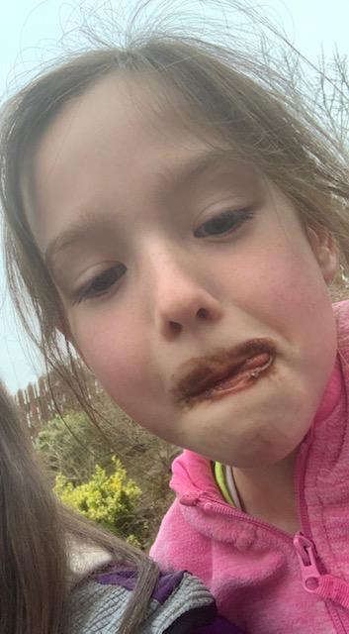
Lockdown life
By Mollie Tumilty Y5
Mrs Adams/Mrs Bentley

Slide 2
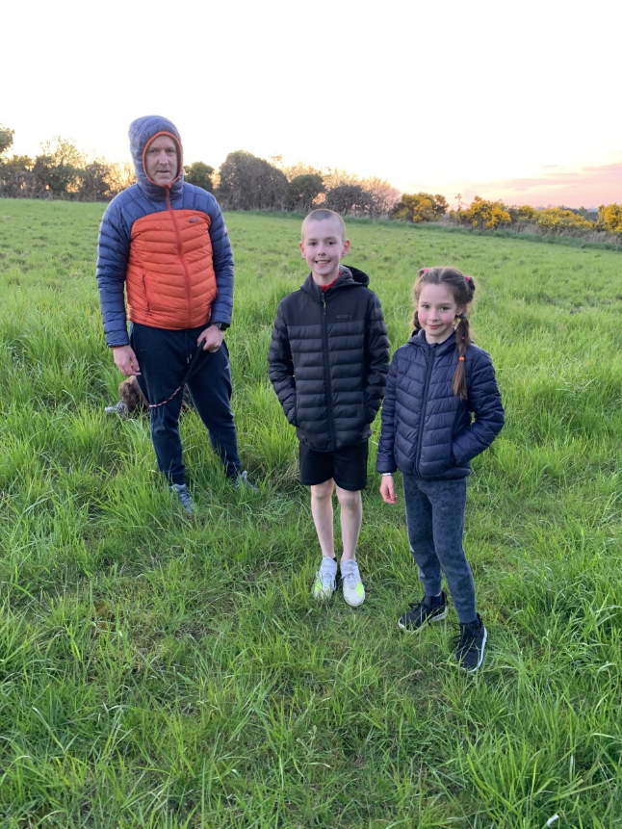
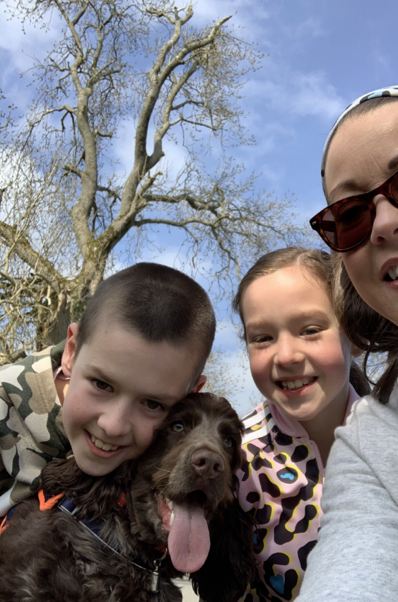
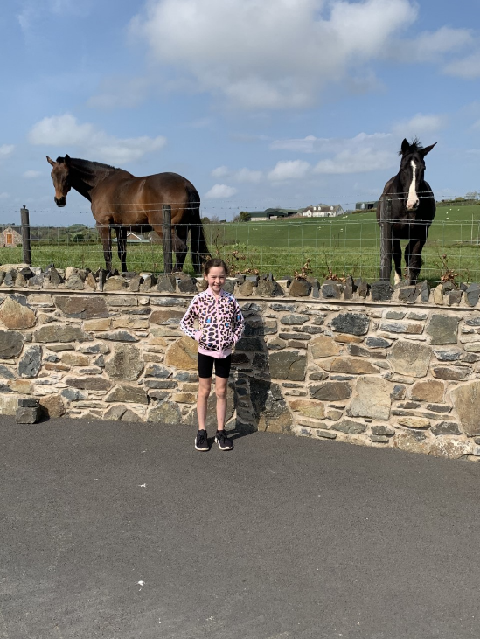
I have been going for lots of walks with my family around Dromore!

Slide 3
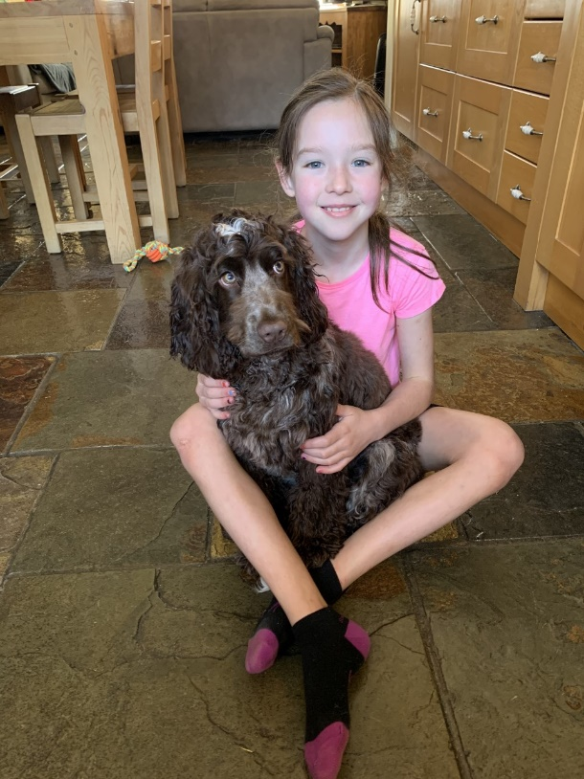
I have been playing with and training my puppy Finn!
Video – press play!

Slide 4
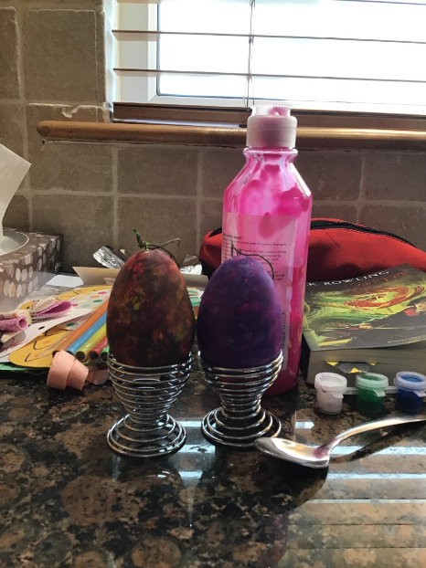
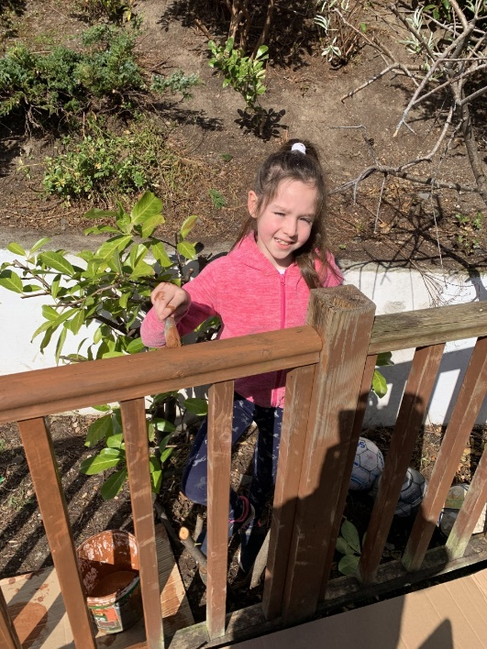
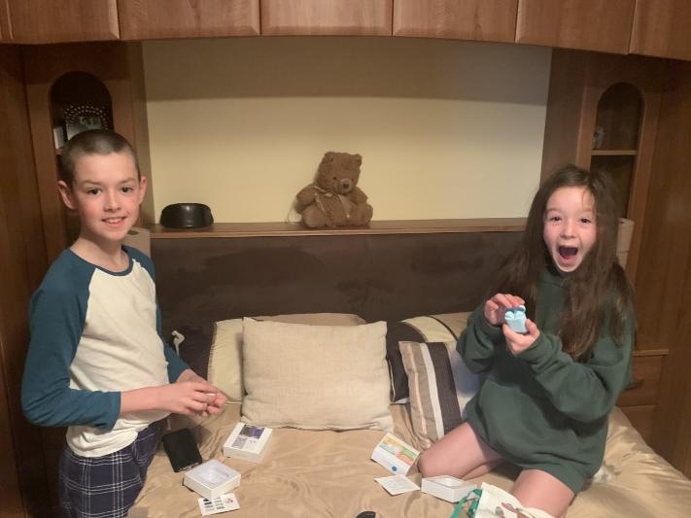
Easter!!
Easter crafts
Every day over EasterI helped paint the fence around our house!
Easter egg hunt!

Slide 5
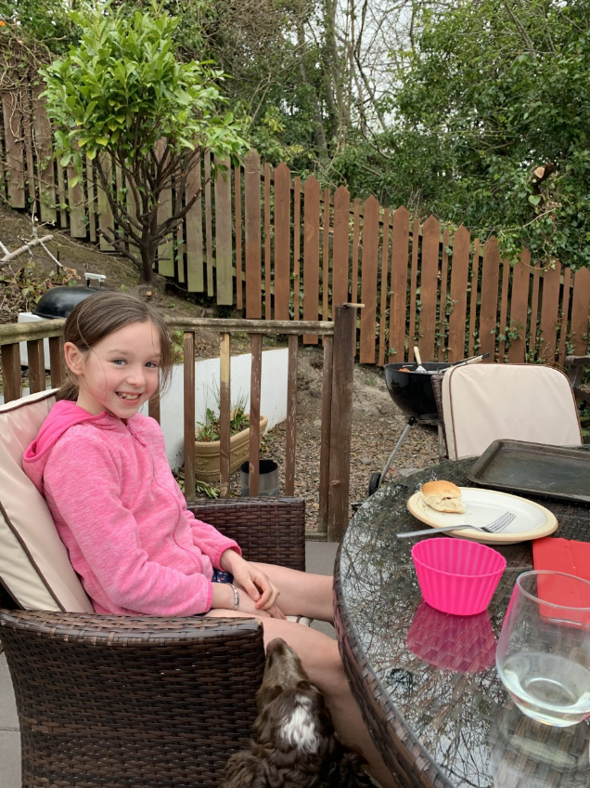
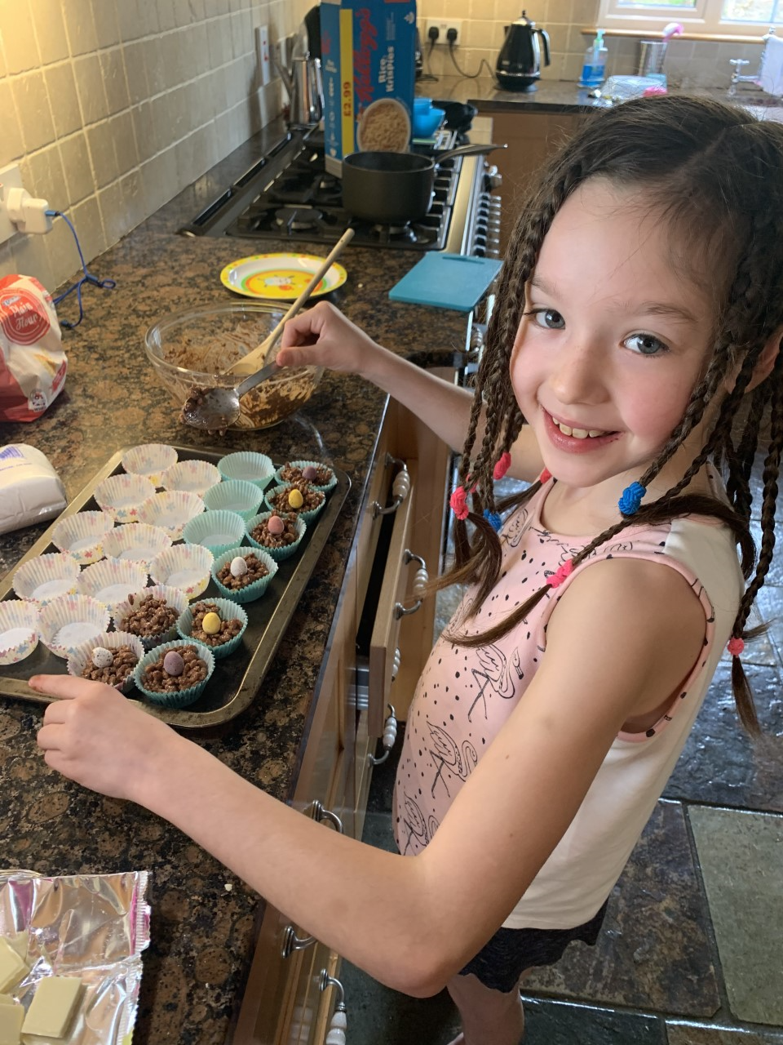
Barbequing and baking!

Slide 6
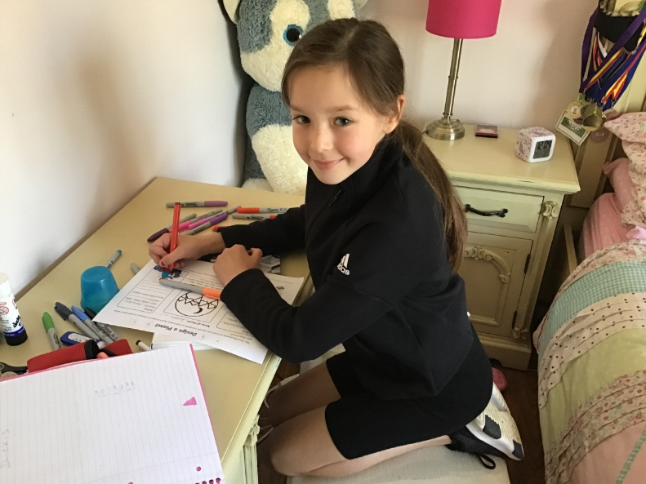
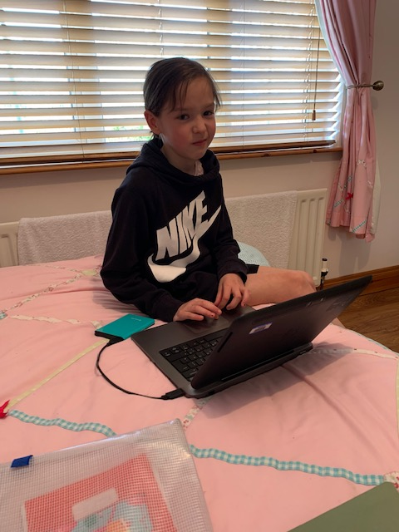
Don’t worry…..I have also been doing my school work!

Slide 7
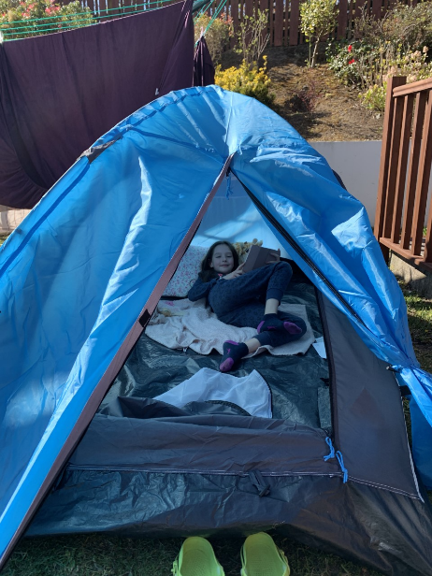
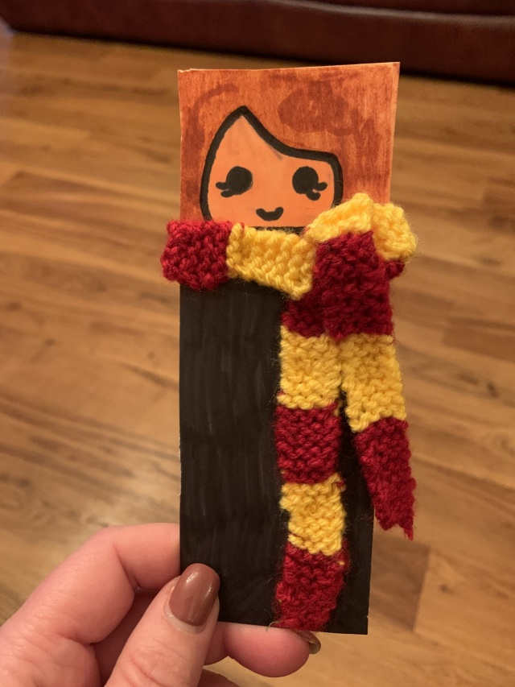
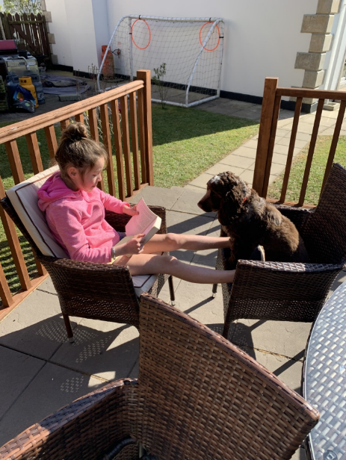
I have been loving reading the Harry Potter series ( I am now on the second book) and doing HP craft activities!

Slide 8
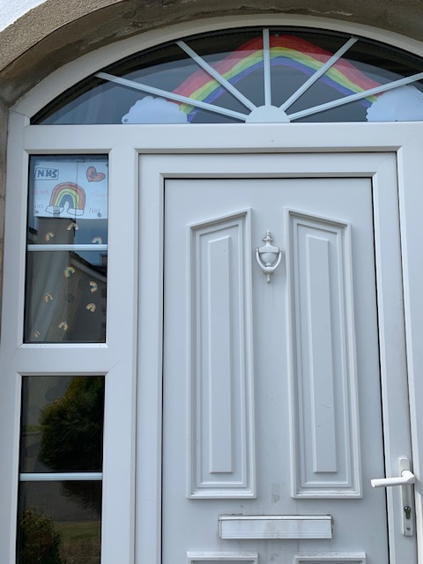
We have said thank you to the NHS by clapping every Thursday!

Slide 9
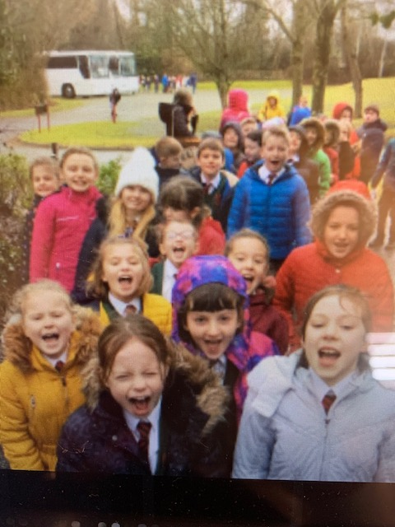
But most of all I have been staying home and staying safe, but I miss my friends and my teachers!

