Slide 1
BIG CATS
BY MILLIE MCCOO

Slide 2
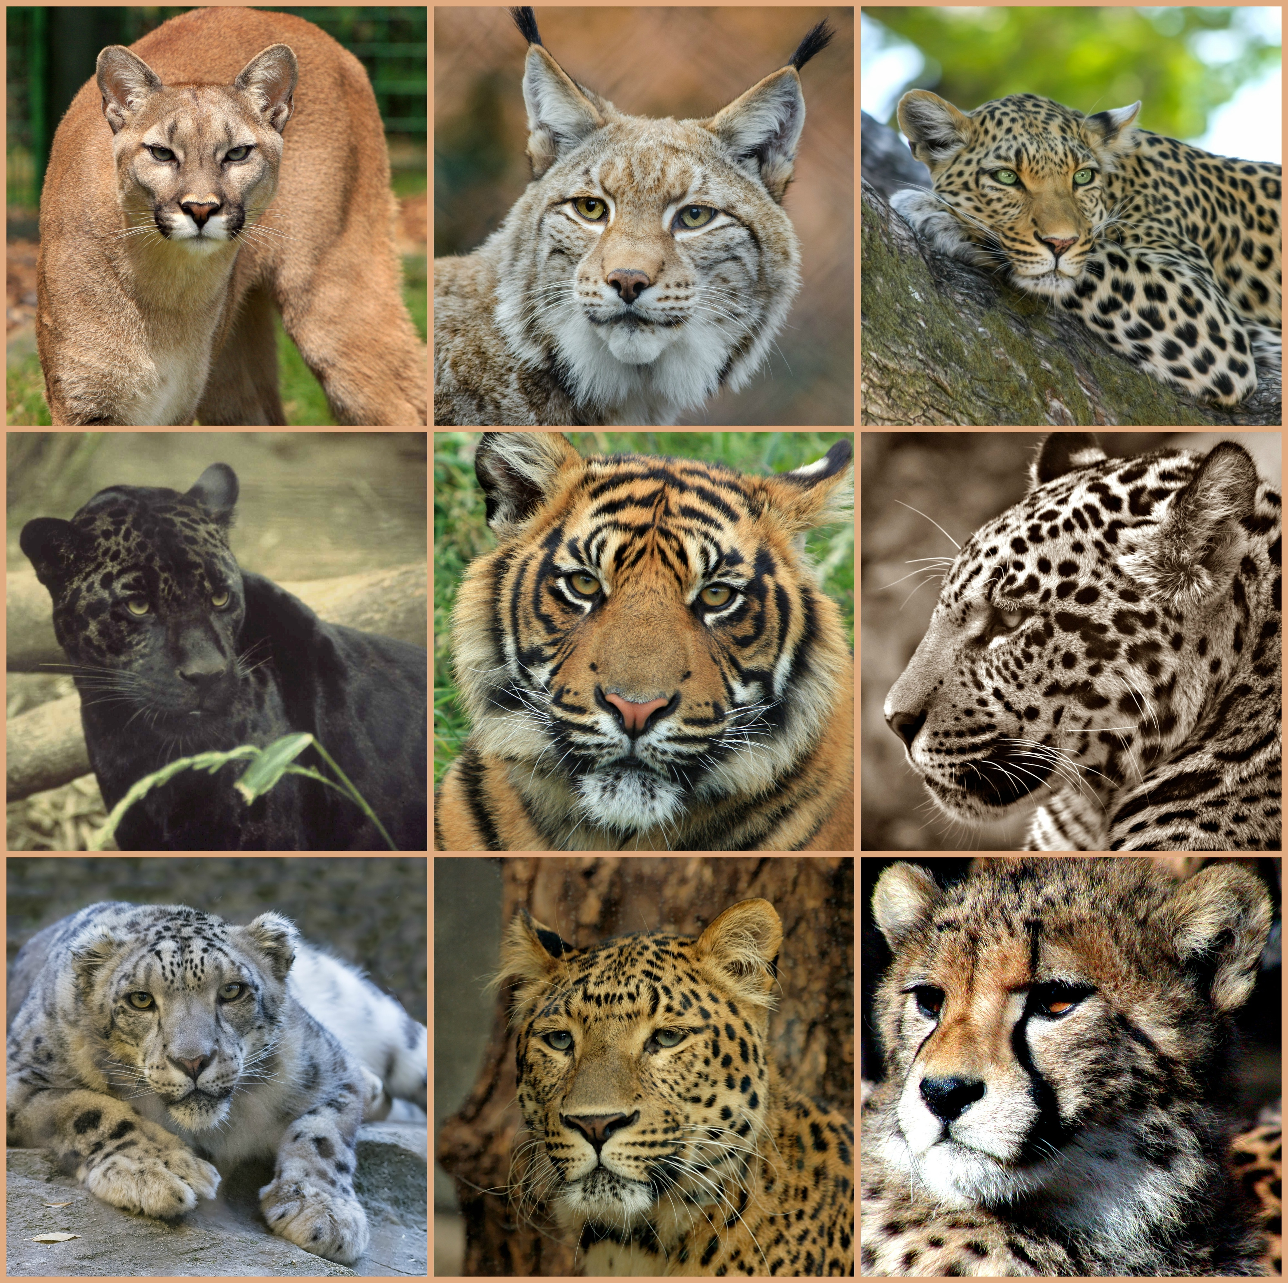
BIG CAT SPECIES
THERE ARE 38 SPECIES OF CATS ON THE PLANET, BUT ONLY 5 TRUE BIG CATS:
TIGERS
LIONS
JAGUARS
SNOW LEOPARD
LEOPARD
CHEETAHS AND COUGARS ARE MORE CLOSELY RELATED TO DOMESTIC CATS

Slide 3
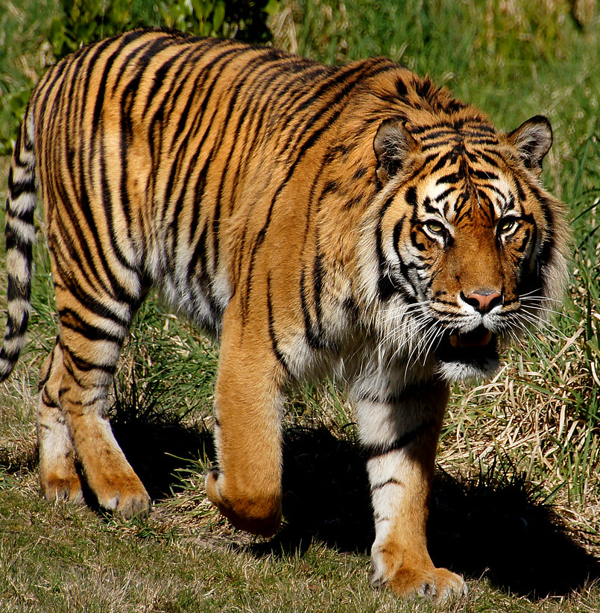
TIGERS
THESE ARE THE BIGGEST OF THE BIG CATS
CAN WEIGH UP TO 600 POUNDS
CAN BE UP TO 11 FOOT LONG
DIFFERENT VARIETIES OF TIGER; SIBERIAN, BENGAL, SUMATRAN, SOUTH CHINA TIGER AND MALAYAN TIGER.
LIVES IN MAINLY ASIA
CAN SWIM WELL

Slide 4
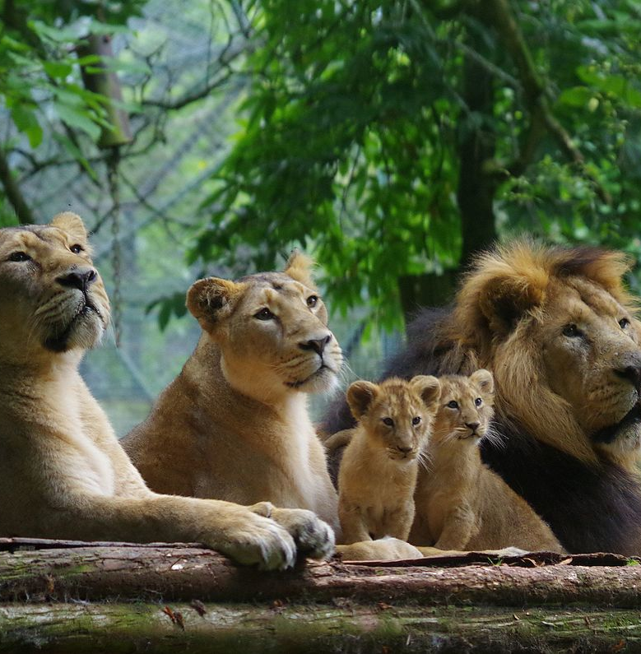
LION
SECOND BIGGEST BIG CAT
HAS THE LOUDEST ROAR
HUNTS IN PACKS
WEIGH 265-420 POUNDS
4.5-6.5 FEET LONG
THE MALES HAVE A MANE
IS A SOCIAL CAT WHICH IS UNUSUAL
LIVE IN ‘PRIDES’
WHOLE OF PRIDE SHARES IN RAISING OF CUBS
LIVES IN AFRICA
This Photo by Unknown Author is licensed under CC BY-SA

Slide 5
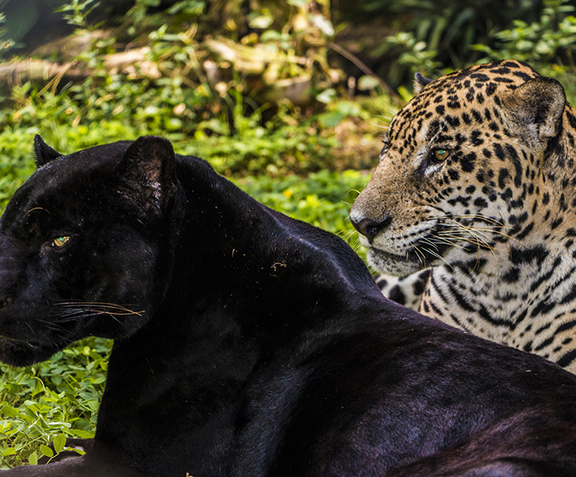
JAGUAR
3RD LARGEST BIG CAT
LIVES IN SOUTH AMERICA
ENJOYS SWIMMING
IS A SOLITARY CAT
5-6 FEET LONG
WEIGH 100-250 POUNDS
LOOKS LIKE A LEOPARD BUT IT STURDIER AND BIGGER
THEY CAN ALSO BE BLACK BUT YOU CAN SEE THE SPOTS AND STRIPES UNDERNEATH THE BLACK
This Photo by Unknown Author is licensed under CC BY-SA

Slide 6
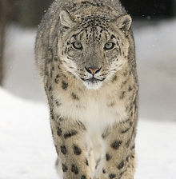
SNOW LEOPARD
LIVES IN THE MOUNTAINS IN ASIA
ADAPTED TO LIVE IN THE COLD WITH THICK HAIR AND FUR COVERED PAWS, THEIR TAILS ARE LONG AND WRAP ROUND THEMSELVES TO PROTECT AGAINST THE COLD.
WEIGH 60-120 POUNDS
ARE 4-5 FEET LONG
ARE SHY AND RECLUSIVE
This Photo by Unknown Author is licensed under CC BY-SA

Slide 7
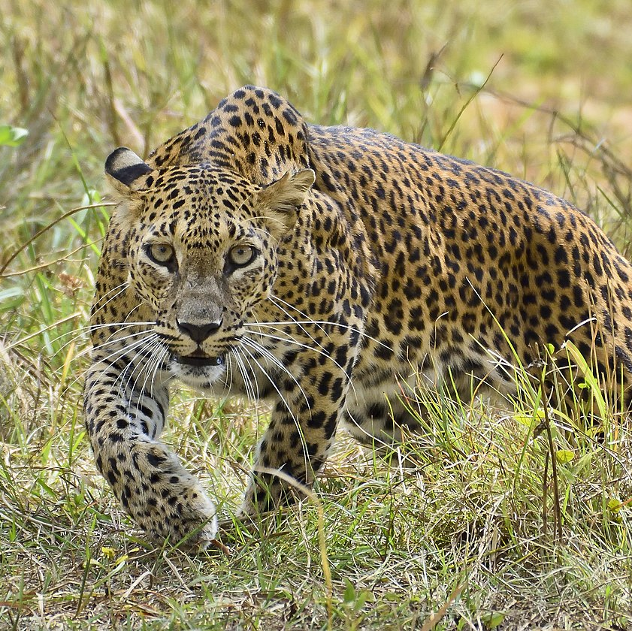
LEOPARD
THEIR FUR PATTERNS ACT AS CAMOFLAGUE WHEN PREYING ON ANIMALS
4.25-6.25 FEET LONG
WEIGH 66-176 POUNDS
LIVE IN AFRICA AND CENTRAL ASIA
VERY GOOD AT CLIMBING TREES AND OFTEN HAULS PREY UP TREES
ARE SOLITARY CATS
This Photo by Unknown Author is licensed under CC BY-SA

